Slide 1
Introduction to Git and Github
By Zach Bergson

Slide 2
Who am I, why do I know Git/Github, and what is version control?

Slide 3
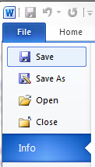
Version control or git, is the save button x 1,000,000
Not only does it allow you to revert to previous changes more easily, it also gives you the ability to collaborate with your peers, create new working branches, and effectively manage your coding projects
Some of the biggest github repositories have millions of collaborators

Slide 4


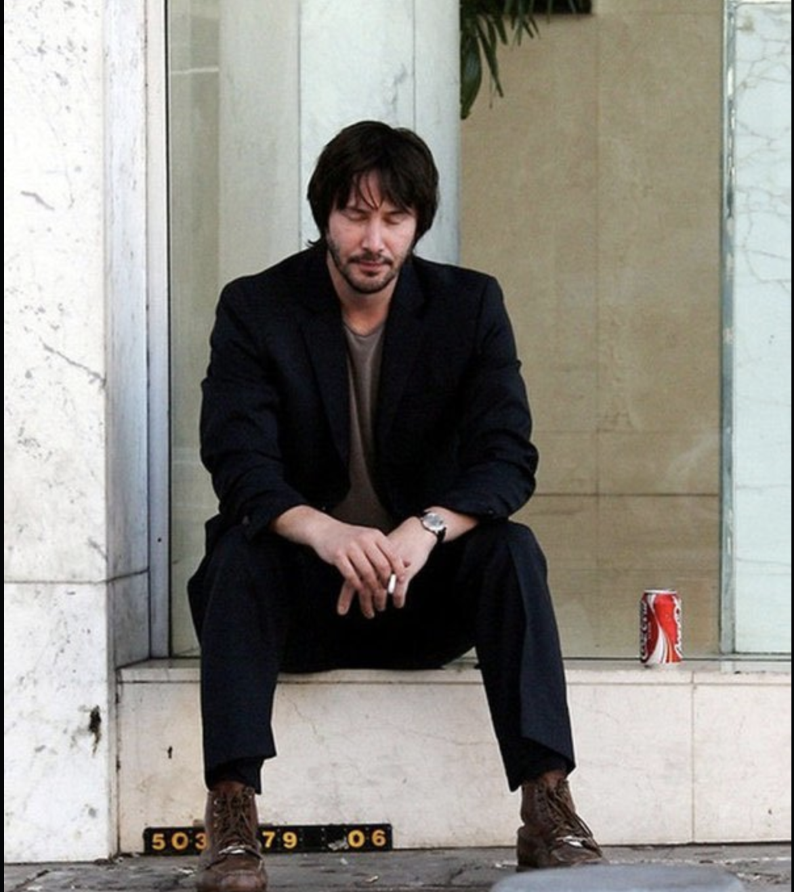
*the Graduate Center and the QMSS program don’t condone smoking, but strongly condone staying in a keanu-zen-like state while coding
Notes:
Before we get started, I want to tell you all the secret of coding: the best coding comes when you find your happy place. If you let the code stress you out, you’ll keep circling over the same problem over and over.
Instead of getting stuck in a loop, I want you to emulate Keanu when you’re feeling like you’re in a hole you’ll never get out of. I don’t condone cigarette smoking or excessive sugar consumption, but I’m sure you all can find the same happy place Keanu has found in these pictures.

Slide 5

Just to reiterate...
Notes:
When you’re stuck, think Keanu drinking a coke, not Ben smoking a pity cigarette!

Slide 6
Installation!
Mac -> https://git-scm.com/download/mac
Windows -> https://gitforwindows.org/

Slide 7
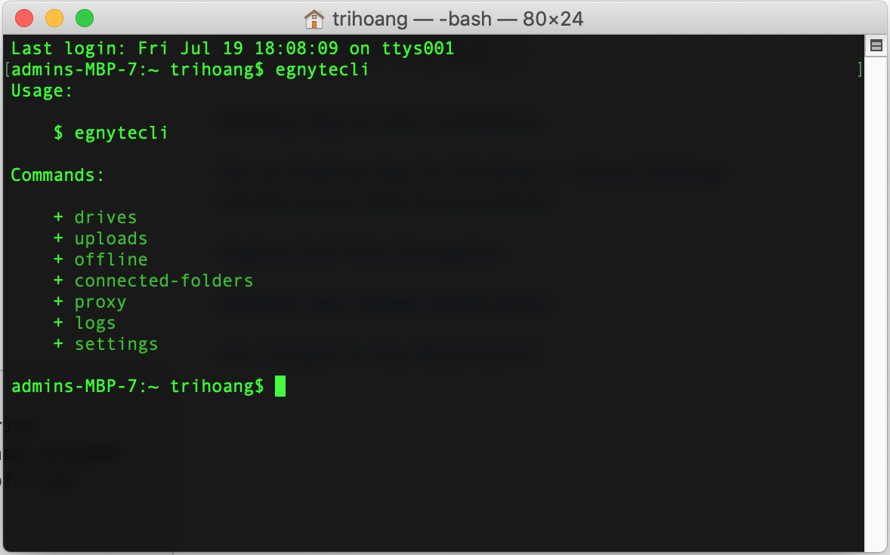
The Command Line
Mac: Finder -> Applications -> Utilities -> Terminal
Windows: Because its location varies depending on the version of windows you’re using, please follow the instructions here -> https://www.lifewire.com/how-to-open-command-prompt-2618089
Notes:
There are various git GUIs that simulate the command line.
Down the line, however, these systems could prove limiting
How many of you have used the command line before?
Don’t worry if you haven’t used it or even know where to find it, I will help you.
Dont let this discourage you, but writing software is generally easier on macs than windows

Slide 8
Navigating to your project file
Create a project folder and place the text file I gave you inside
Please do this in your downloads folder
You don’t need the command line to do this!
Mac users: Paste “cd ~/downloads/[name-you-came-up-with]” into your terminal
Windows users: “cd downloads/[name-you-came-up-with]” into your terminal
Notes:
The ~ in the mac means the home folder

Slide 9
Initialize your repo and make changes
Type “git init” into your command line and hit enter
Nothing exciting should happen, the command line will simply go to the next line and await another directive
Now, go to the text file I provided you and make changes. You can make many changes, one change or even delete all of the text.

Slide 10
Saving our changes
Git is watching everything you’re doing on initialized repos
Type “git status” and hit enter
What do you see?
Even though it’s always watching, git won’t keep a permanent record of your files unless you add and commit your changes
If you’re ready to commit your changes please type and execute:
“git add .”
“git commit -m ‘[any message of your choosing]’”
Notes:
Git status alone doesn’t provide you with much info, but built in git GUIs can serve as useful visual aids to your project

Slide 11
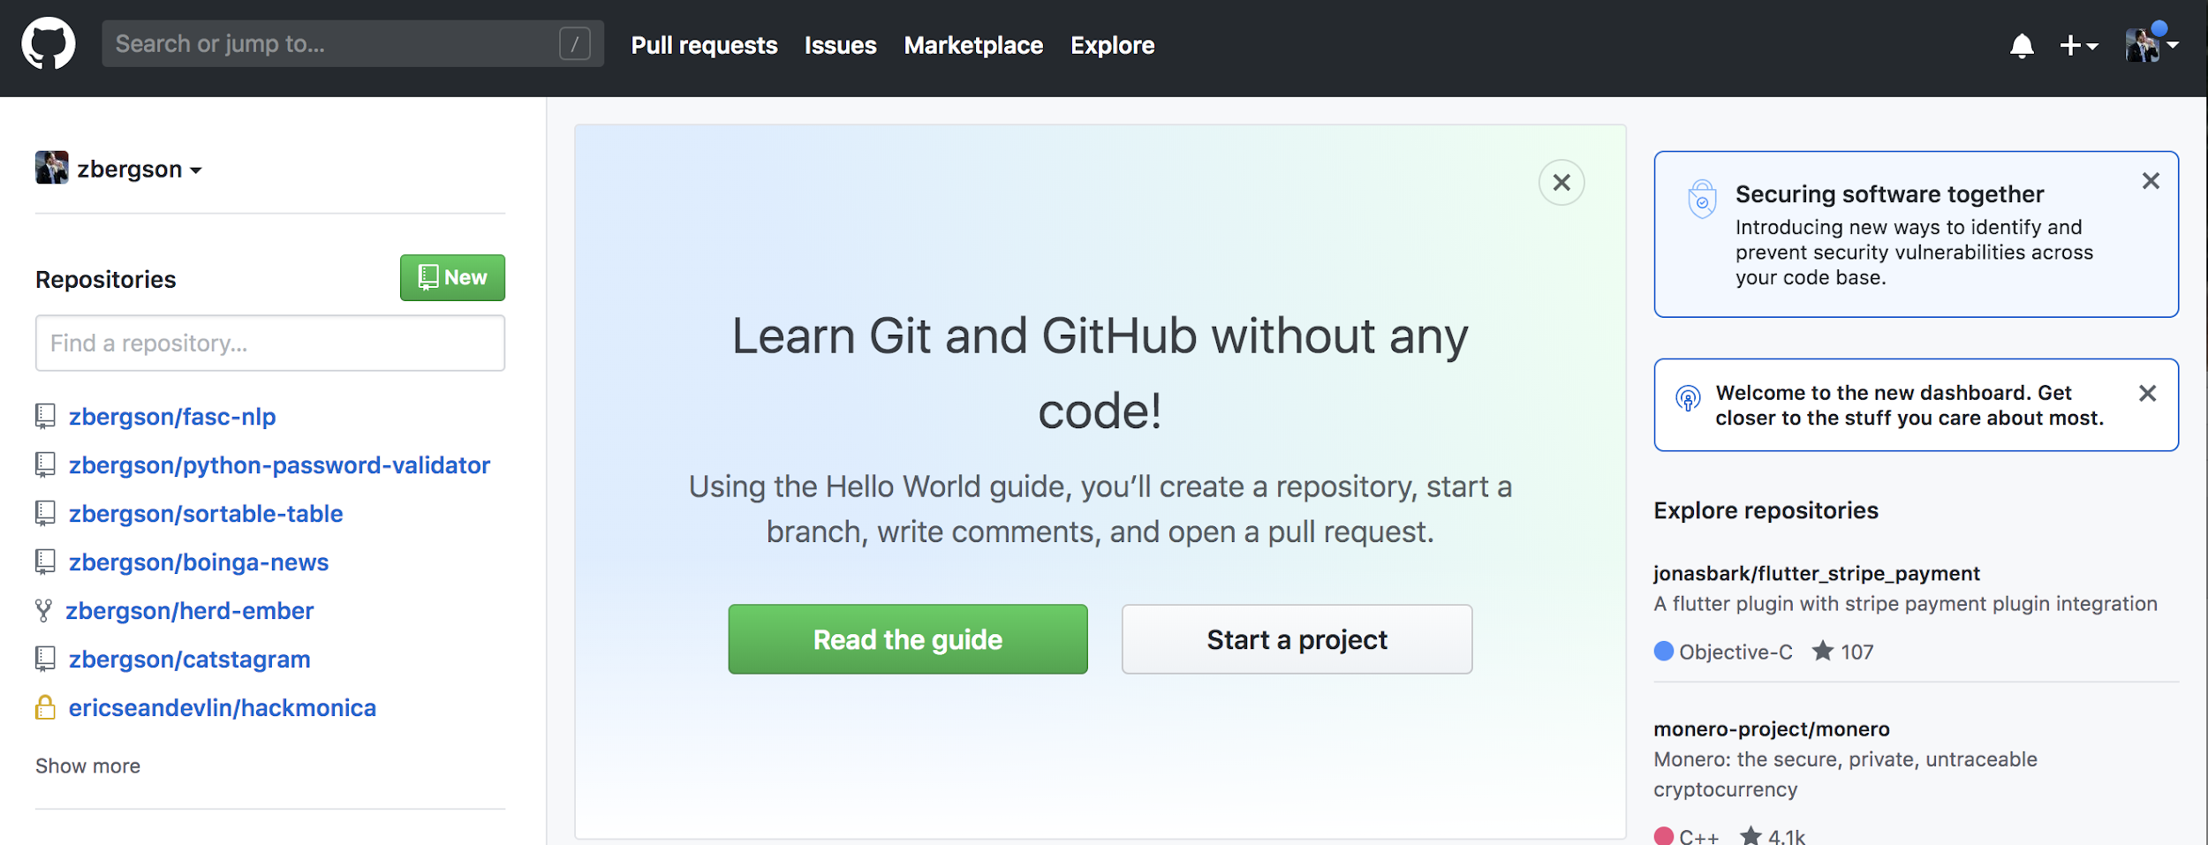
Connecting to Github
Make an account
Click “start a project”

Slide 12
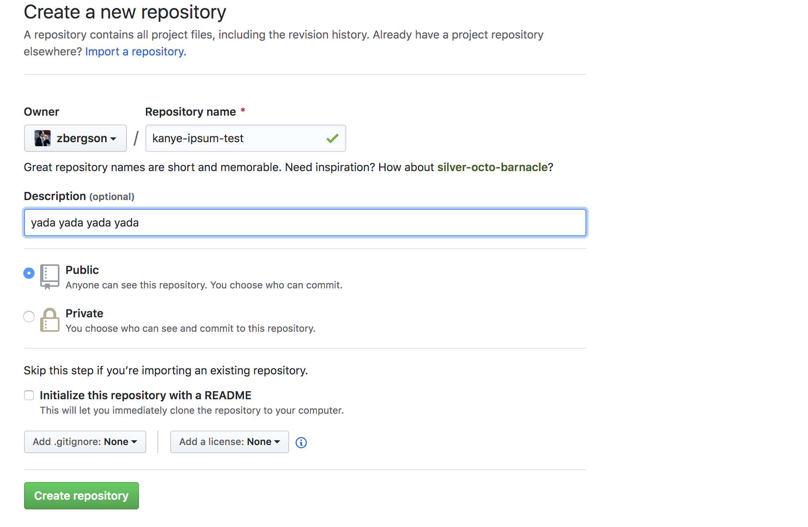
3. Give your repo a name
4. Do NOT select initialize with README
5. Select “Create repository” when you’re ready!
Don’t select this!

Slide 13
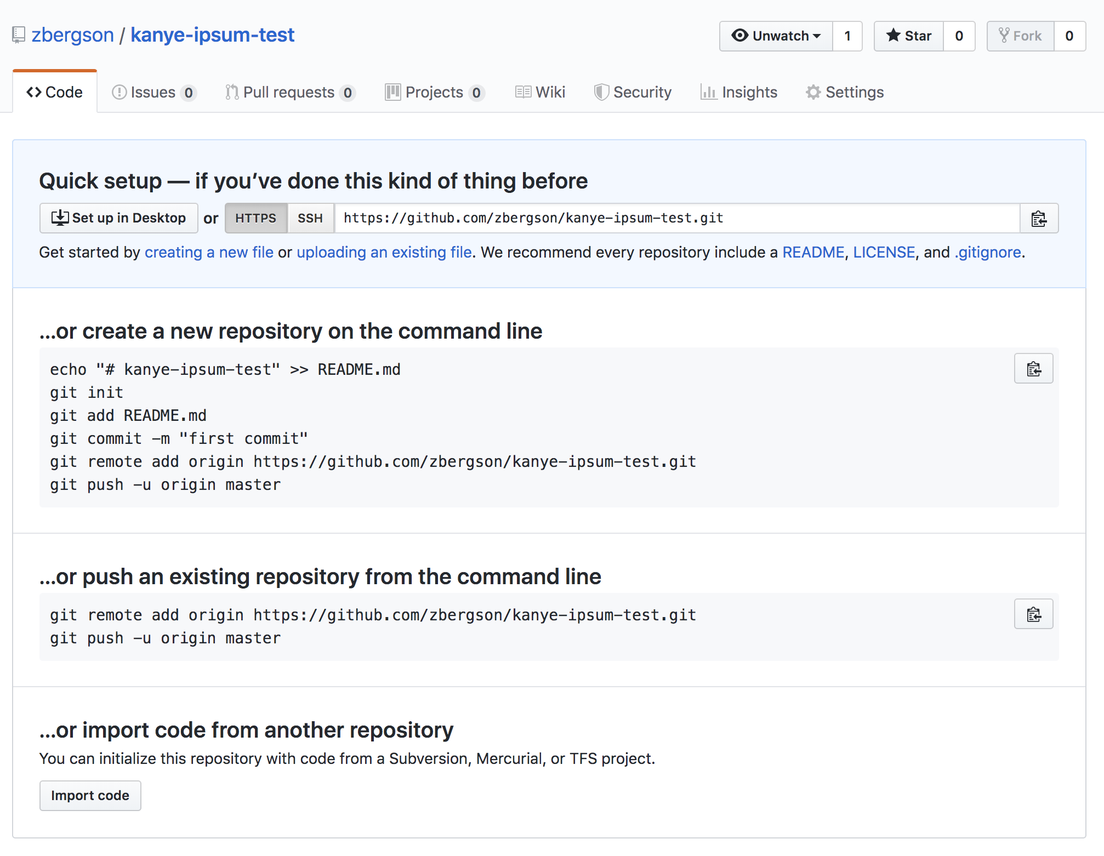
Pushing existing code to Github
After you create your repo, you’ll see this page below.
Because a local repo already exists on your machine, we will use the “push an existing repository” option
Please copy and paste each line from this field and execute them in order on your command line

Slide 14
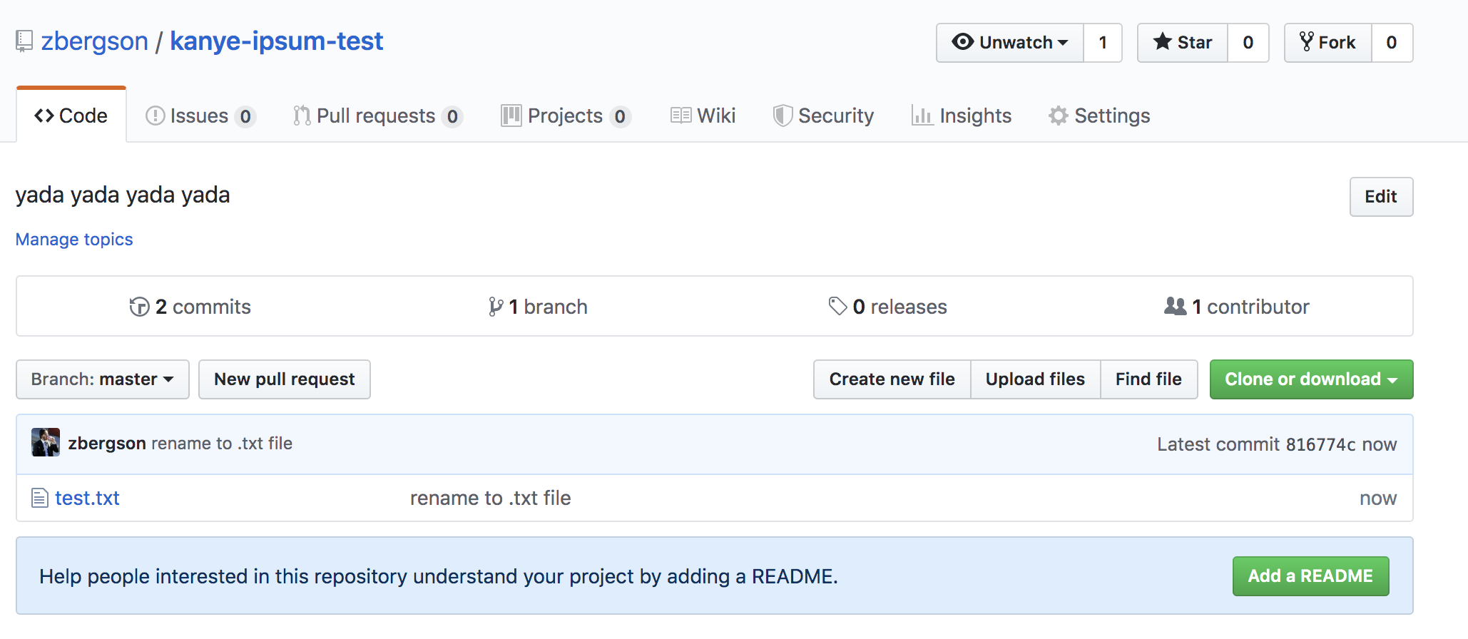
… Pushing existing code to Github
Now, when you return to Github (you might have to refresh the page), you should see your new repo containing your text file

Slide 15
You’ve got the basics down!
But there’s still a lot to learn, and only a limited amount of time for this workshop
What’s more, git and coding in general is best learned self-directed
With this in mind, I’ve come up with three challenges for you all to tackle in the remaining time we have here or at home
When in doubt, Google!

Slide 16
Three challenges
Make another commit and then revert back to the first commit we made today
HINT: type “git log” to see a list of your previous commits, or look at your commit history on github
Create a new “branch” and merge this branch into you master branch
HINT: “git checkout -b [new-branch-name]” will get you started
Collaborate with one of your classmates and pull down their repo onto your machine
Once you do this, open their repo, create a new branch and push your code to their remote repo on github
If you’ve gotten this far, submit a “pull request” and have your partner merge you code onto master

Slide 17
Email: zach.bergson@gmail.com
Github: @zbergson

